Slide 1

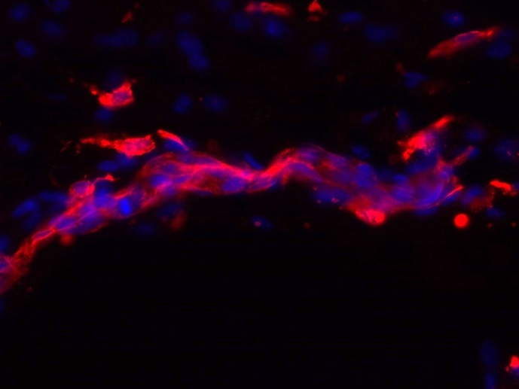
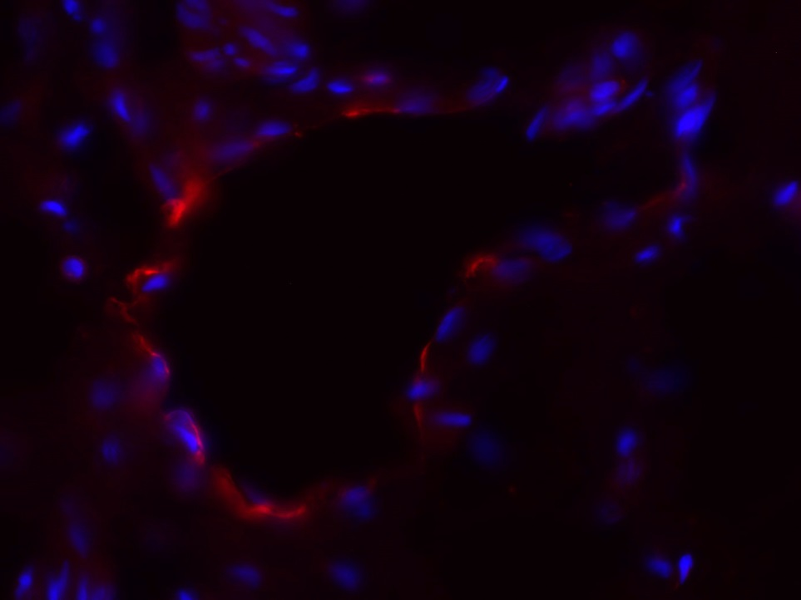
ReliaTech GmbH
Rabbit anti-mouse LYVE-1
(Cat #103-PA50AG; K24836)
K22973
K22974
K24836: mouse skin (E17.5)
K24836: human foreskin
Immunofluorescence staining (red) of cryo-sections of mouse skin day 17.5) (left panel) and human foreskin (right panel) with anti-mouse LYVE-1 (5µg/ml) [Cat# 103-PA50AG] and counter staining of nuclei with Dapi (blue).
The experiment was performed by the research group of Prof. Dr. J. Wilting and Dr. K. Buttler, University Göttingen, Germany.
http://www.reliatech.de / orders@reliatech.de

